Slide 1
PRONTO
Seattle's cycle sharing system with 500 bikes and 50 stations located throughout the city.
By: Ashkan Dastani and Damilare Olaleye

Slide 2
The dataset acquired from https://www.kaggle.com/pronto/cycle-share-dataset has information of almost 142,000 bicycle trips taken in the city.
This dataset also includes data variables which helped us to know the numeric ID of the bike, start/stop time of the trip, bike ID to recognize which bike was used for which trip, total trip duration, the starting and ending station/points of the trip, user type if people had short term passes to use the bikes and lastly the gender of the individual’s using the facility.
With the given information and predefined variables, we were able to generate some interesting graphs which depicted interesting patterns that could help facilitate better and faster methods for the company.

Slide 3


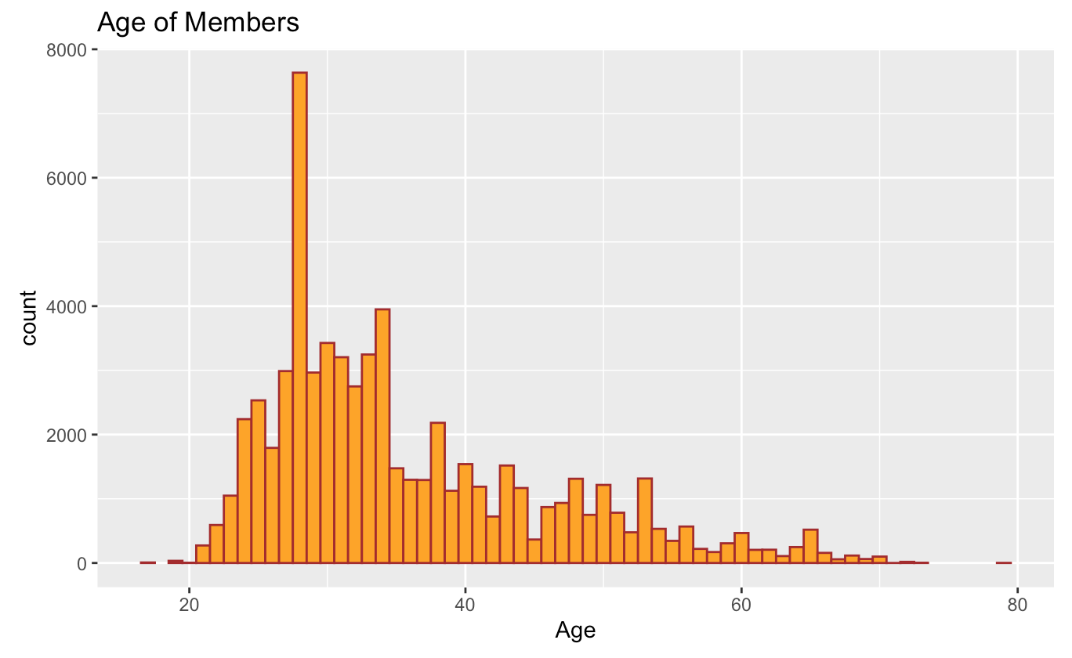
WHAT AGE GROUP UTILIZES THIS MORE
From the dataset, we were able to find the approximation of which age group uses this facility more in the city.
Not to a surprise, majority of users of these bike range from 20 to 40.
It was also interesting to see that age groups under 20 do not use the bike service a lot.
There is also a big drop in the usage of bike as the age gets close to 30.

Slide 4
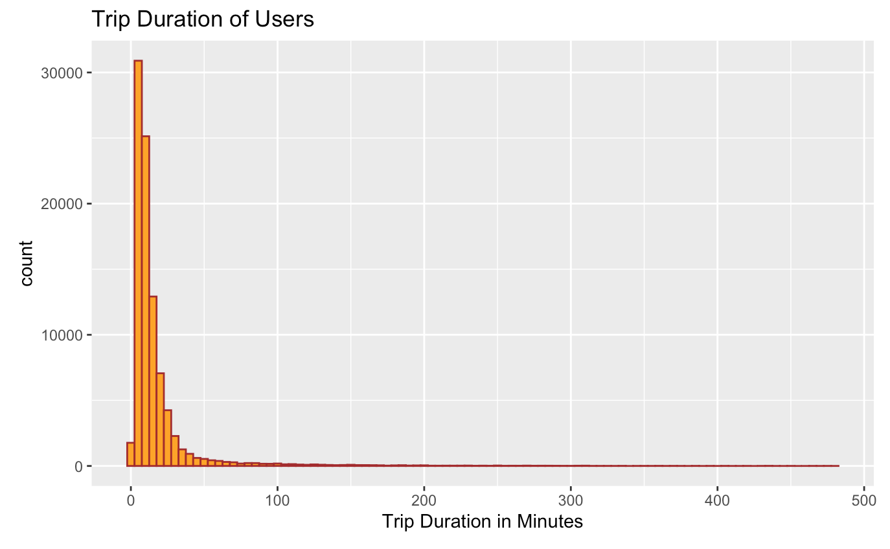
Duration of trips
To know the usage of this service, it is important to know how long the trips usually are.
We were able to generate a graph which can give us the estimation whether the trips are long or short.
From the graph produced, it is obvious that most of the trips are shorter, and after the one hour mark the number of trips begins to decline and became very low.

Slide 5
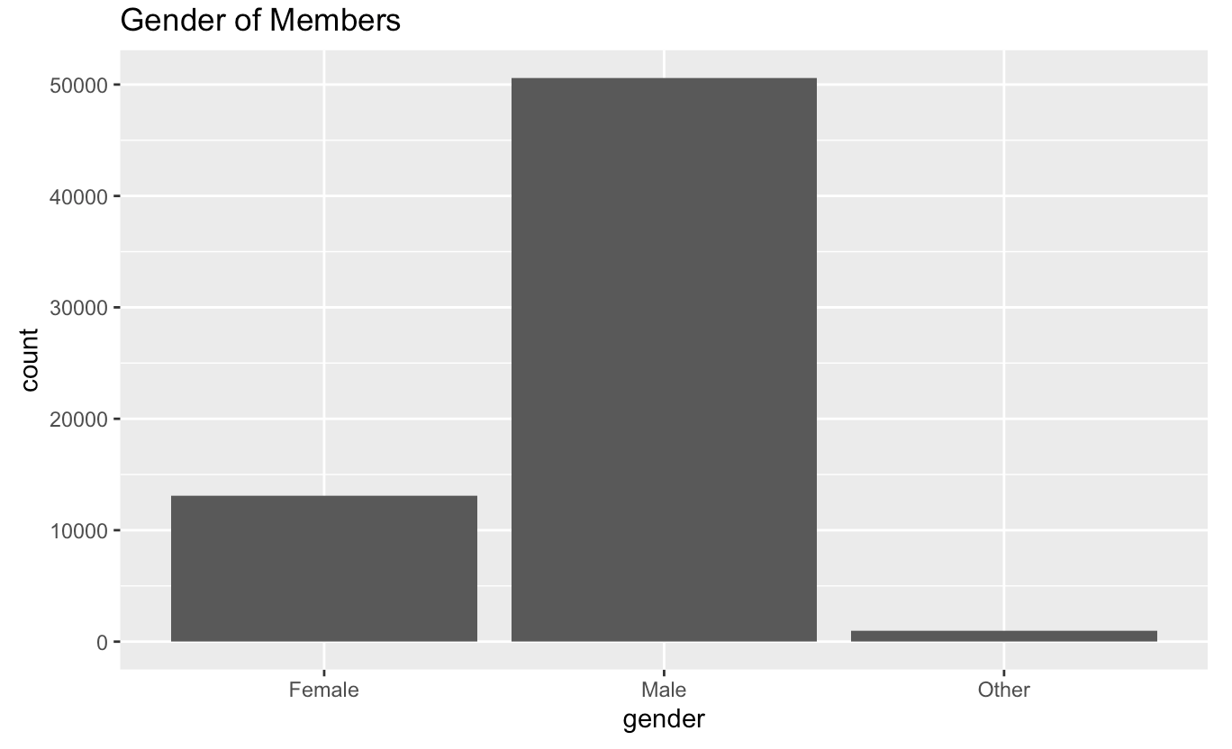
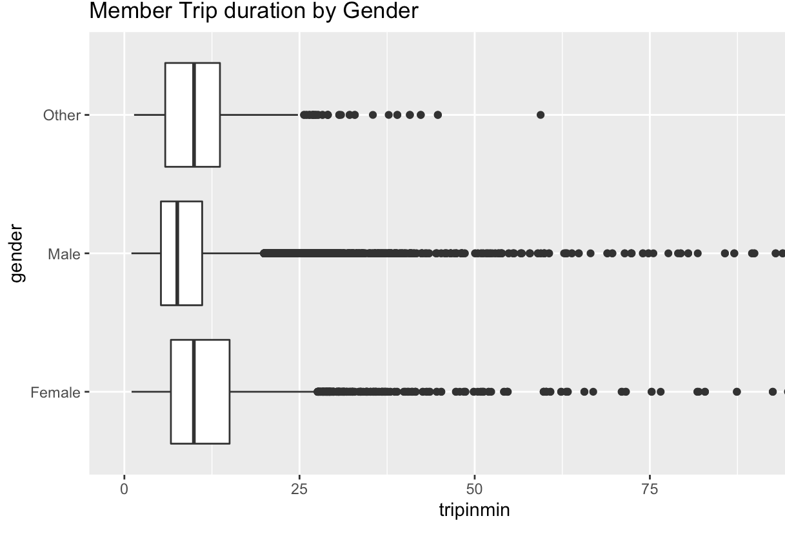
Which gender uses this service more.
When is comes to providing service, there always a section which comes under consideration; that is the gender.
When is generated a graph for this dataset. We were able to see that the majority of users were male when compared to female and others.
Interestingly we were also able to gather the trip duration of each gender and saw that female and other categories on average takes longer trips than male, the graph shows a very large number of outliers.

Slide 6
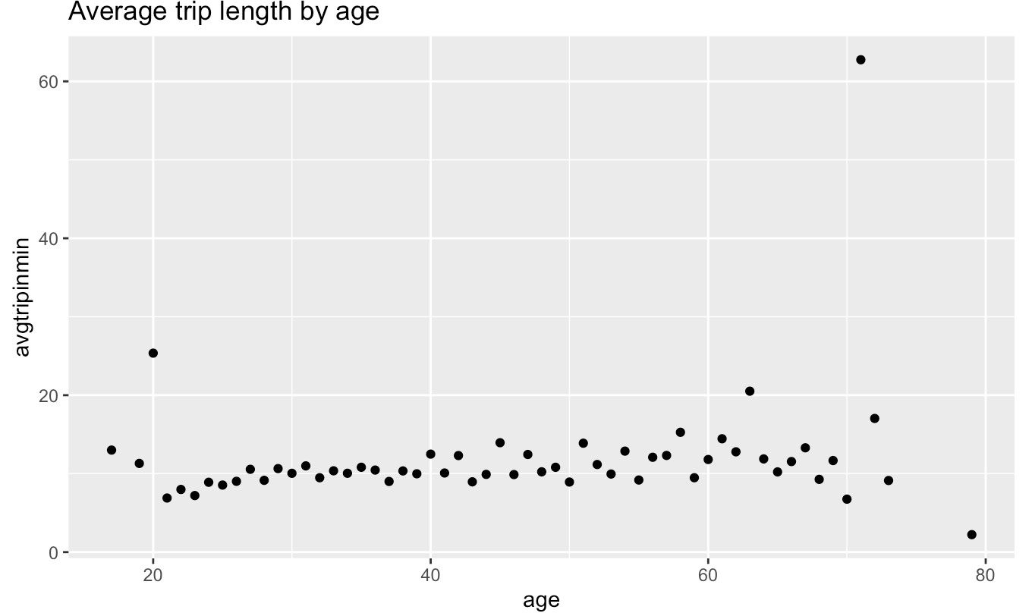
Trip length by age
Since we had all the information on age, length and gender. We wanted to also see how the length of a trip is affected with age.
The graph here shows the average is below 20 minutes, and that the large averages are between 71 and 79 year old group. The 84 year olds have 1 and the 71 years old have 2 users. The 79 year old group with 1 user shows that it's just one of them taking a long trip.

Slide 7
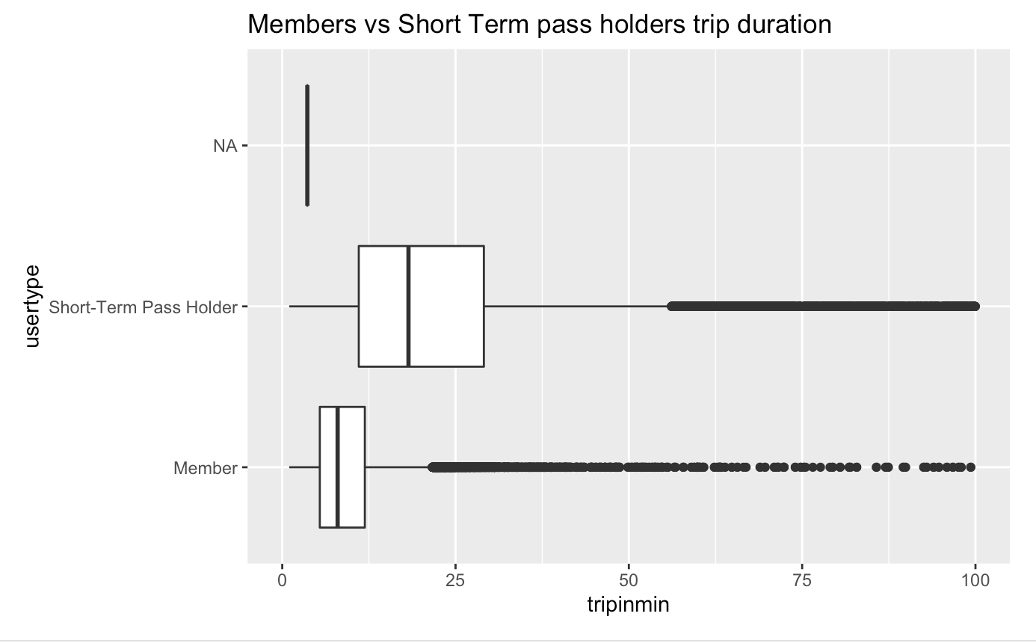
Short term Pass holders
The dataset we got had a short term pass holder variable which helped us create a graph which showed how short term pass holder vary from normal people using the facility.
The short-term pass holders on average had the longer trips compared to the members. There are large number of outliers from the groups, but the members have more outliers than the short-term pass holder.

Slide 8
Start/stop stations
Knowing which station the bike is picked up and dropped is a vital data for the company.
We created functions are let us know which stations were used the most and which ones were used least.
The least popular stations to depart from are Pronto shop, 8D OPS 02, Pronto shop 2, Pier 66 / Alaskan Way & Bell St, UW McCarty Hall / Whitman Ct, and Thomas St & 5th Ave N. The most popular stations to depart from are Pier 69 / Alaskan Way & Clay St, E Pine St & 16th Ave, 3rd Ave & Broad St, 2nd Ave & Pine St, Westlake Ave & 6th Ave, and E Harrison St & Broadway Ave E.
The most popular stations to arrive at are 2nd Ave & Pine St, Pier 69 / Alaskan Way & Clay St, Westlake Ave & 6th Ave, 3rd Ave & Broad St, PATH / 9th Ave & Westlake Ave, and Occidental Park / Occidental Ave S & S Washington St.

Slide 9
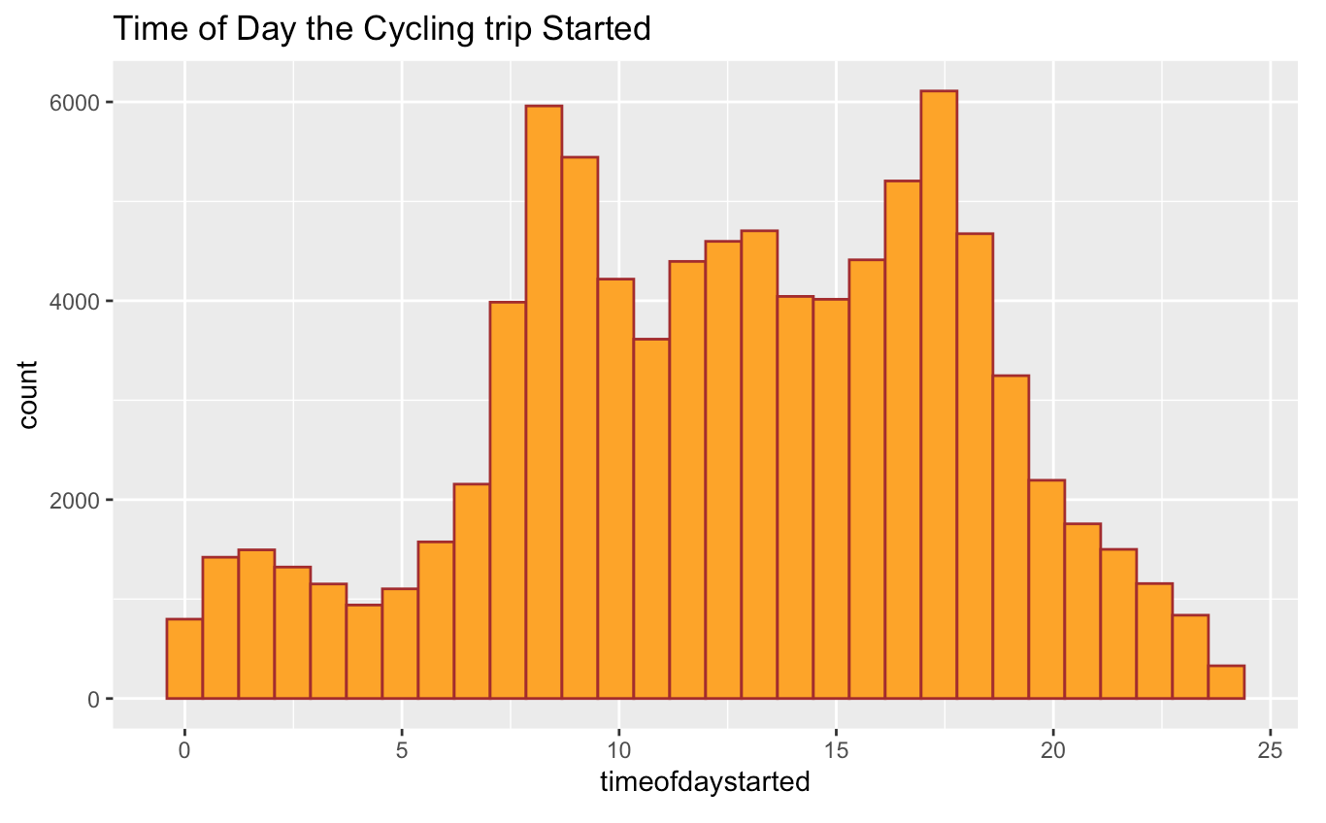
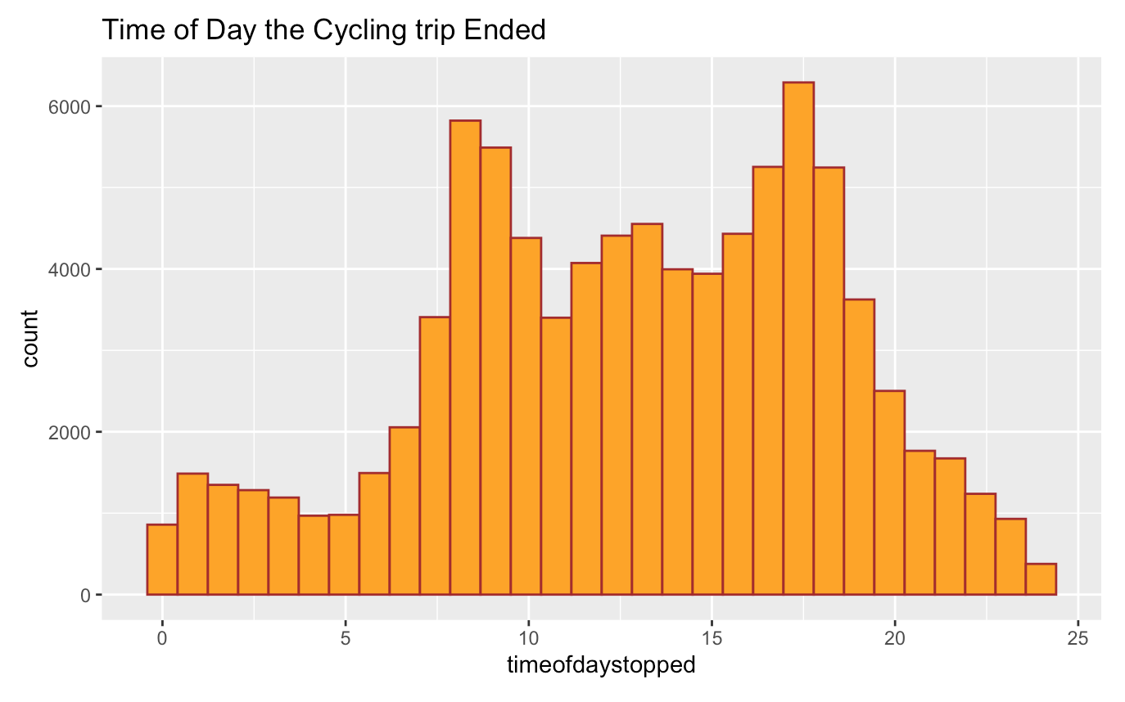
Time period started and ended.
Lastly, we wanted to check the time (day/night) the bikes were used the most. We also wanted see what time the trip started in the day and what time is ended.
We generated graphs which showed people are taking trips just before 10am or just before 8pm. There are very few late at night or very early in the morning. This however correspond to the hours you would go to or leave work, a 9am-5pm or 8am-4pm work cycle.

Slide 10
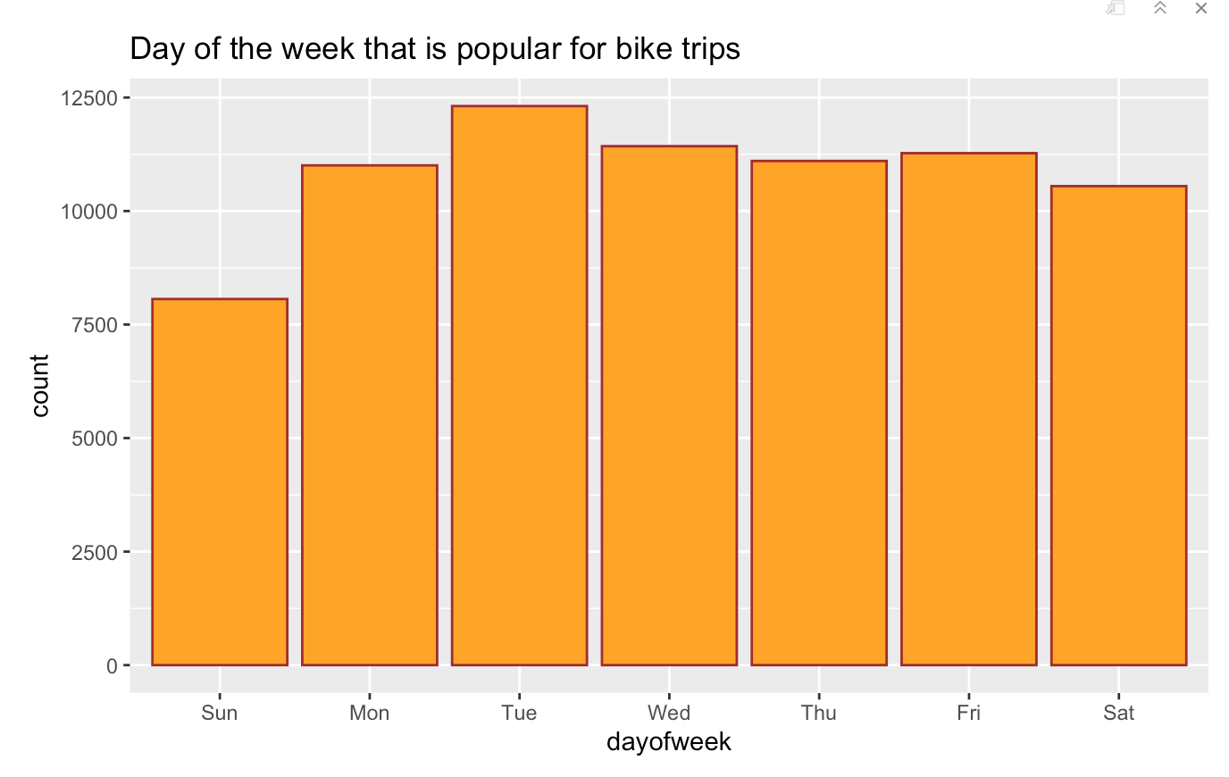
Popular days for bike trips
From the dataset we were able to generate information on which days of the week, the bike rides are used the most.
Upon generation of the graph, we see that the least popular day to use the bike sharing is on Sunday, while Saturday is the second least popular day for a trip. All of the week days are fairly similar to each other but Tuesday is the day of the week that is popular for bike trips.

Slide 11
Thank you

